Slide 1
Harr-cascade

Slide 2

Viola-Jones Algorithm
The Viola-Jones algorithm is a widely used mechanism for object detection.
The main property of this algorithm is that training is slow, but detection is fast.
The efficiency of the Viola-Jones algorithm can be significantly increased by first generating the integral image.
Detection happens inside a detection window. A minimum and maximum window size is chosen, and for each size a sliding step size is chosen.

Slide 3
Viola-Jones Algorithm
Set the minimum window size, and sliding step corresponding to that size.
For the chosen window size, slide the window vertically and horizontally with the same step. At each step, a set of N face recognition filters is applied. If one filter gives a positive answer, the face is detected in the current widow.
If the size of the window is the maximum size stop the procedure. Otherwise increase the size of the window and corresponding sliding step to the next chosen size and go to the step 2.

Slide 4
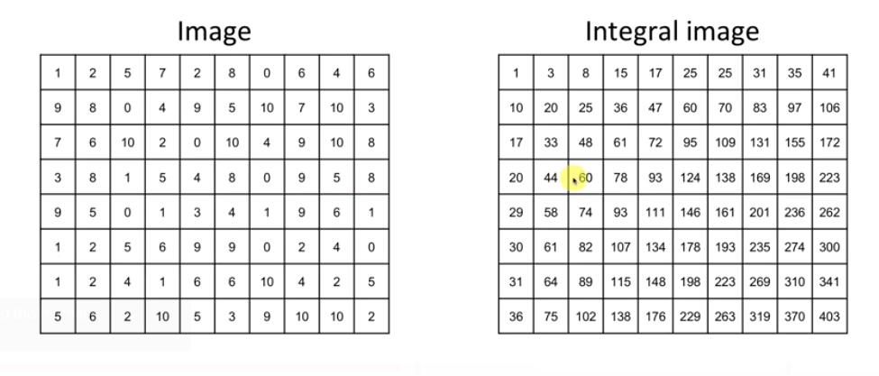
Integral Image

Slide 5
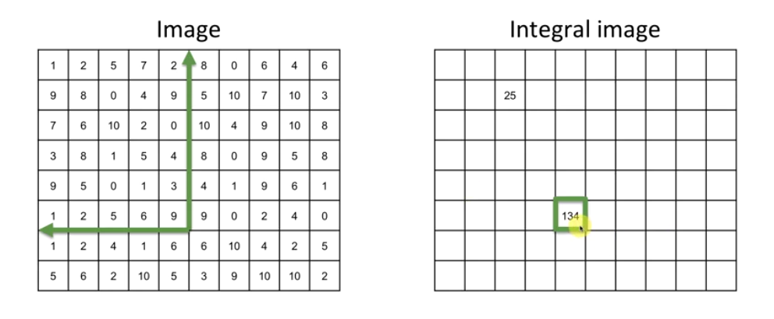
Harr-Cascade

Slide 6
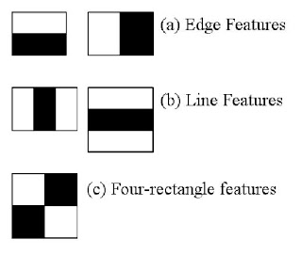
Harr-Like Features

Slide 7
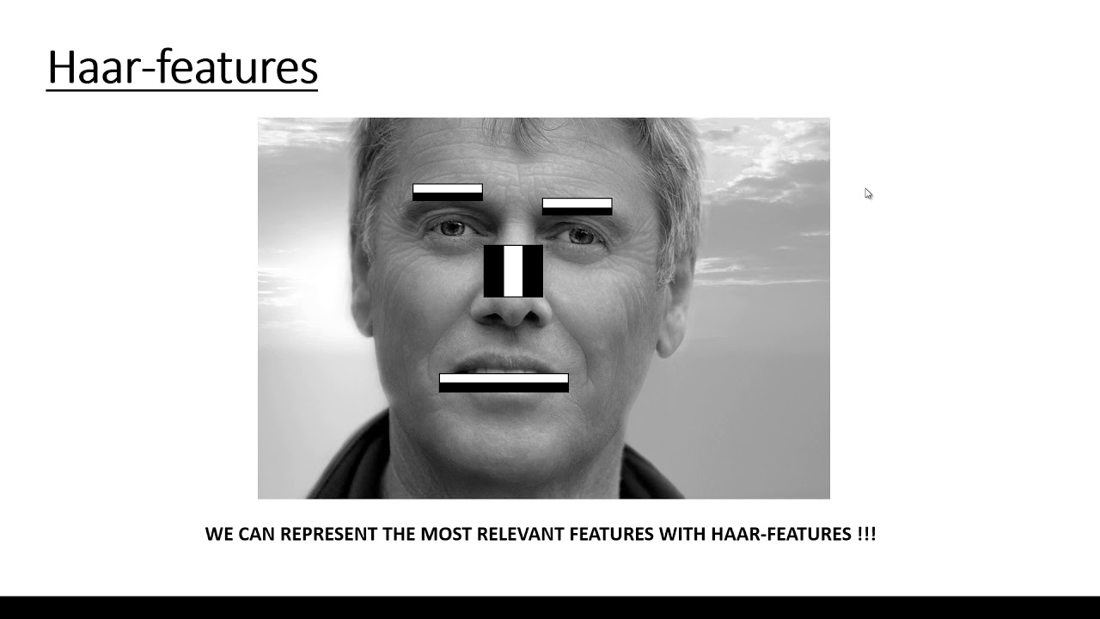
Harr-Like Features Applications

Slide 8
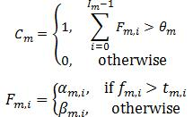
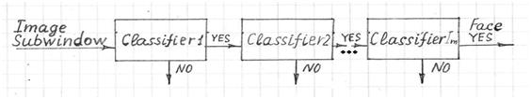
Object detection Viola-Jones filter

Slide 9
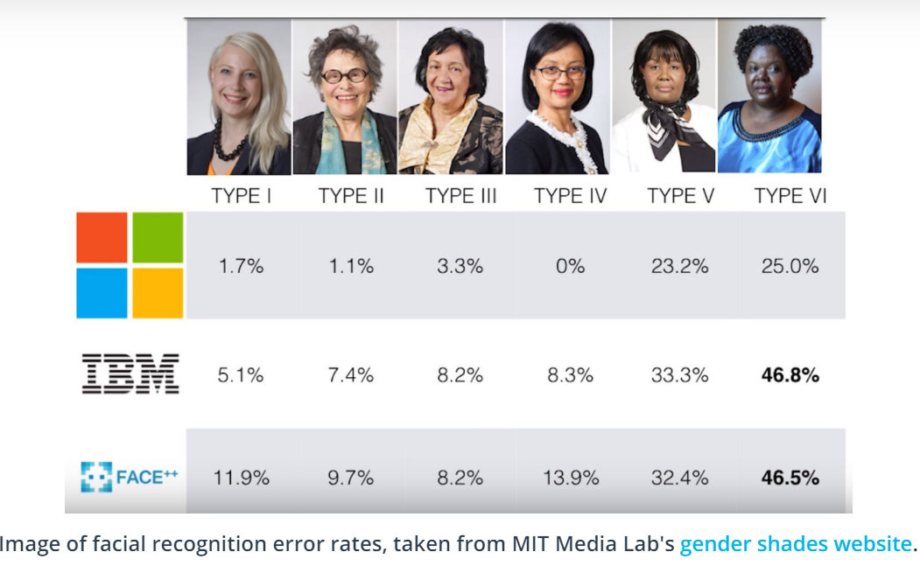
Harr-Cascade

